Slide 1
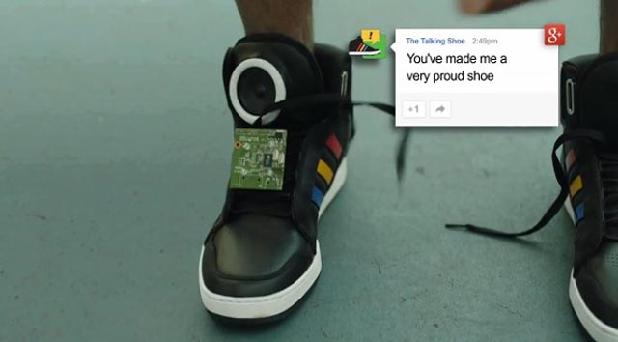
Smart Wearables – Future Shoes
V.S.Roshan,VIII C

Slide 2
Agenda
About Me
Motivation
Project Brief
Project Circuit / Architecture
Code for the project
List of Components used in this project
Demo
Future Enhancement
Appendix – Description about the components used in project

Slide 3
About me
I am V.S. Roshan studying in 8thc in Kendriya Vidyalaya Meenambakkam.
My ambition is to become a Scientist and create products useful for the society.
My research areas include Robotics and Internet of Things
I am developing several prototypes in these areas.
In this science exhibition, I have created a small prototype called “SMART SHOE” , a wearables ,which would be used by senior citizens, blind and physically challenged people for providing automated routing.

Slide 4
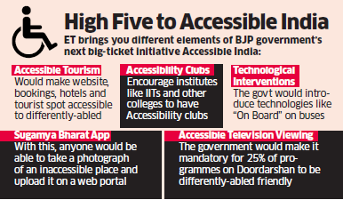

Motivation
285 million people are estimated to be visually impaired worldwide, 39 million are blind and 246 have low vision as per “World Health Organization” and there are more than 7.8 million blind people in India .
Supporting Digital India and Disability Initative of our honourable Prime Minister Mr. Narendra Modi

Slide 5
Project Brief
What is Smart Shoe V1?
Smart shoe is a smart technology footwear in which shoes are connected to a smartphone application and guide the blind people when there is a obstacle before them and give them instruction to turn either left or right. This product will be really useful for them .
Helps as a Navigation aid for blind people and disabled people .
Plan to provide a cost effective, economical solution for the visually impaired .

Slide 6
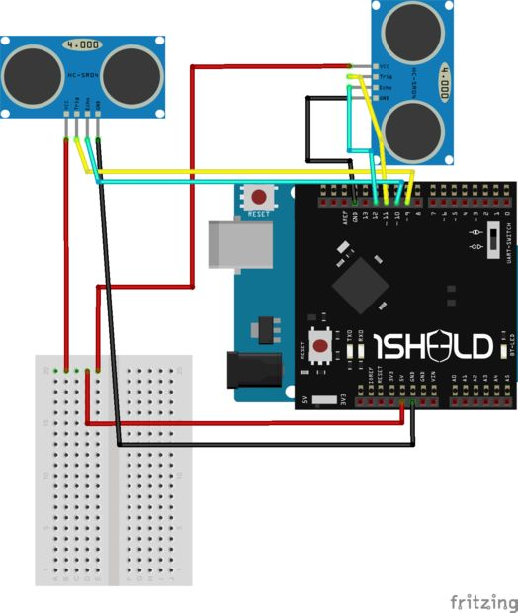
Project Circuit / Architecture

Slide 7
Code for the Project
//First define the libraries and the shields we will use
#define CUSTOM_SETTINGS
#define INCLUDE_TEXT_TO_SPEECH_SHIELD
#define INCLUDE_TERMINAL_SHIELD //this Terminal shield is just to check if everything is going alright as planned
/* Include 1Sheeld library. */
#include <OneSheeld.h>
//Now define the ultrasonic echo and trig pins
const int righttrig = 9; //trig on pin 9
const int rightecho = 10; //echo on pin 10
const int fronttrig = 11; //trig on pin 9
const int frontecho = 12;
//define variables that will memorize the distance
long rightduration;
int rightdistance;
long frontduration;
int frontdistance;

Slide 8
void loop() {
// This block is for ultrasonic distance detection
digitalWrite( righttrig, LOW);
delayMicroseconds(2);
digitalWrite( righttrig, HIGH);//send ultrasonic wave
delayMicroseconds(10);
digitalWrite( righttrig, LOW);
rightduration=pulseIn(rightecho,HIGH);
rightdistance=rightduration*0.034/2; //to turn the distance into cm unit
digitalWrite( fronttrig, LOW);
delayMicroseconds(2);
digitalWrite( fronttrig, HIGH);//send ultrasonic wave
delayMicroseconds(10);
digitalWrite( fronttrig, LOW);
frontduration=pulseIn(frontecho,HIGH);
frontdistance=frontduration*0.034/2;
}
void setup() {
//Start communication with smartphone
OneSheeld.begin();
// Ultrasonic pins setting up modes trigs are OUTPUTs and echos are INPUT
pinMode(righttrig,OUTPUT);
pinMode(rightecho,INPUT);
pinMode(fronttrig,OUTPUT);
pinMode(frontecho,INPUT);
}

Slide 9
//Now the comparison and communication with smartphone part
if(frontdistance<15 && rightdistance<15) //I set it as 15 cm, you can change it if you want to.
{
Terminal.println("Go Left");//Just to check you can remove this line if you don't like it
TextToSpeech.say("Go Left");
delay(1000); //This delay is for the "Go Left" to be read out slowly completely
if(frontdistance<15 && rightdistance>15)
{ Terminal.println("Go right");
TextToSpeech.say("Go right");
delay(1000);
}
if(frontdistance>15 && rightdistance<15)
{
Terminal.println("on your right");
TextToSpeech.say("move forward");
delay(1000);
}
}

Slide 10
List of Components used in this project
Arduino UNO
1 Sheeld
Ultrasonic sensors
A tiny breadboard.-To provide 5 volt source for the sensors.
Arduino Battery Jack-Just to power the arduino while walking.
Jumper wires.
A 9volt Battery.
A shoe.
Nylon cable ties- To attach all the components on the shoe you pick

Slide 11
Demo

Slide 12
The Future Enhancement
GPS module which will guide the user to the destination place he wants to reach.
Health monitoring unit which will place a call on emergency to the nearest hospital.
Activity tracker unit that will look for just step counting , 24/7 heart rate tracking and feedback on workouts like calories burnt.
Notification / Control platform at home for providing information
Make Disabled self sufficient with the wearables by providing navigational aids , feedback and also connecting to the smart stick further on providing more details .
It will also provide instant feedback, notification connected with the home for more information on travel.
Communication in localized Languages.

Slide 13
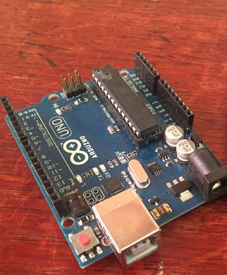
Appendix Description about the components used in project
Arduino UNO
I have used Arduino Uno in my project.
Arduino is an open-source electronics platform based on easy-to-use hardware and software
Arduino boards are able to read inputs - light on a sensor, a finger on a button, or a Twitter message - and turn it into an output - activating a motor, turning on an LED, publishing something online.
You can tell your board what to do by sending a set of instructions to the microcontroller on the board.
To do so you use the Arduino programming language (based on Wiring), and the Arduino Software (IDE), based on Processing.
I

Slide 14
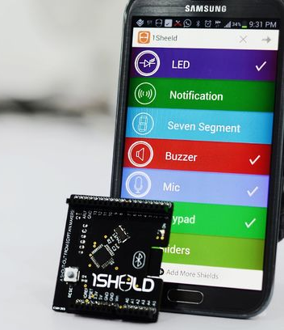
1 Sheeld
I used 1Sheeld board ,the 1Sheeld mobile application and the Text To Speech functions.
It's a board that gives your project the ability to communicate with your smart phone.

Slide 15
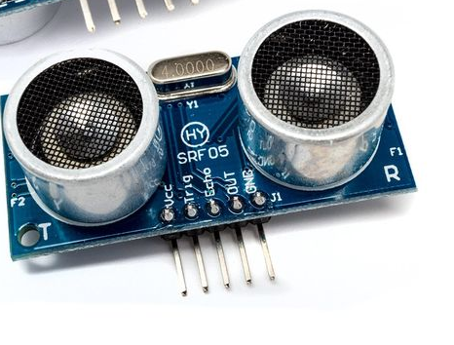
Ultrasonic sensors
Ultrasonic sensors detect the distance in front of them, so we will use them to detect how far the obstacles are.

